Slide 1

Transform
POWER WORKSHOP SERIES

Slide 2
SUPER LIVING WITH SUPERFOODS

Slide 3
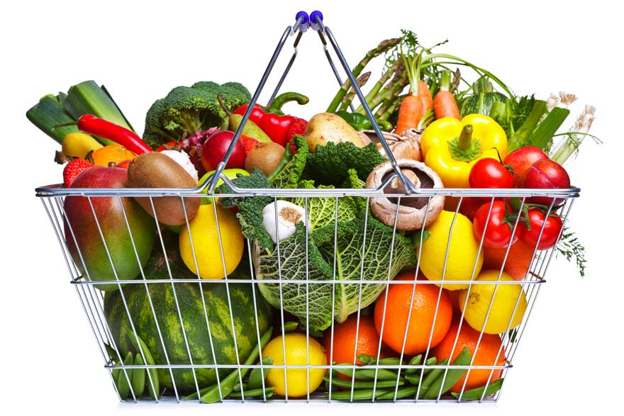
SUPERFOODS
Must Fulfill 3 QUALIFICATIONS:
Readily Available To The Public
Contains Nutrients That Are Known To Enhance Longevity
Health Benefits Have To Be Backed By Peer-reviewed, Scientific Studies.

Slide 4
SUPERFOODS
You Don't Need Specific Foods For Specific Ailments.
A Healthy Diet Incorporating A Variety Of Superfoods Will Help You Maintain Your Weight, Fight Disease, And Live Longer.
"Every Superfood Is Going To Be A 'Real Food”
Ref: Nutritionist Elizabeth Somer, Author Of Nutrition For A Health Pregnancy, Food &Amp; Mood, And The Essential Guide To Vitamins And Minerals.

Slide 5
SUPERFOODS
They Are Loaded With Phytonutrients That Are Non-vitamin, Non-mineral Components In Food That Provide Health Benefits.
They Are Proven To Help Prevent And Reverse Aging, Cardiovascular Disease, Type Ii Diabetes, Hypertension, Certain Cancers, Dementia, And Extend Your Health Span.

Slide 6
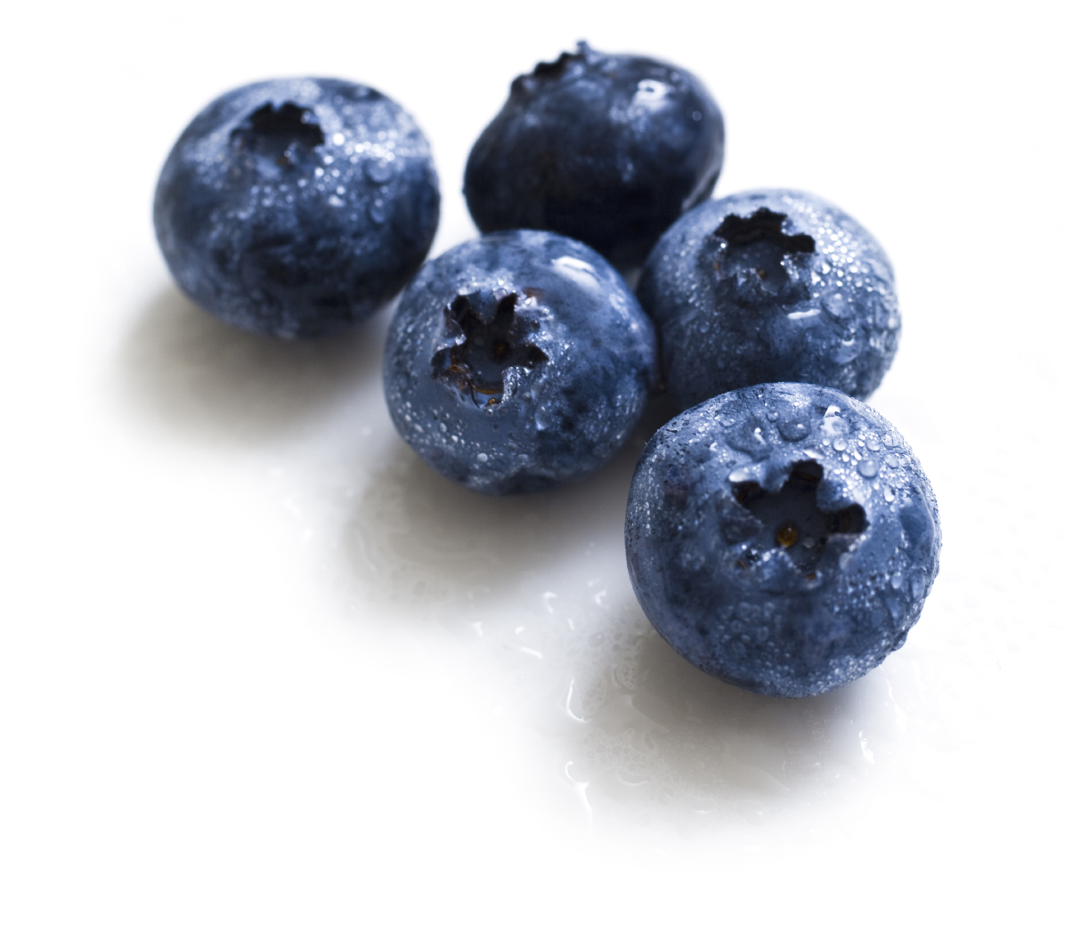
TOP 15 SUPERFOODS
BLUEBERRIES
Incredibly High Levels Of Antioxidant Phytonutrients.
Help The Body Cells Communicate With Each Other More Efficiently, Prevent Mutations At The Cellular Level, Prevent The Proliferation Of Cancer Cells
Recommended That 1 To 2 Cups Of Blueberries Should Be Consumed Daily To Obtain The Full Health Benefits Of This Amazing Fruit.
Notes:
REF: Dr. Pratt- Superfood Rx
the healthful benefits of blueberries stem mainly from their incredibly high levels of antioxidant phytonutrients.
Phytonutrients are non-vitamin, non-mineral components of food that have significant healthful benefits. There are literally thousands of different types of phytonutrients, and each phytonutrient is unique in both its physical characteristics and its function. Research has shown that phytonutrients help the body cells communicate with each other more efficiently, prevent mutations at the cellular level, prevent the proliferation of cancer cells, and there is still much more that we are learning about the powers of phytonutrients everyday. Blueberries are so rich in phytonutrients that even though they are not filled with the antioxidant vitamins C and E, the still provide as much antioxidant protection to the body as 1,733 IU of vitamin E and more than 1200 milligrams of vitamin C.
It is recommended that 1 to 2 cups of blueberries should be consumed daily to obtain the full health benefits of this amazing fruit.

Slide 7
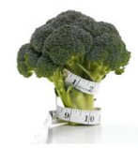
TOP 15 SUPERFOODS
BROCCOLI
A Researcher At Johns Hopkins University Announced The Discovery Of A Compound Found In Broccoli That Not Only Prevented The Development Of Tumors By 60% In The Studied Group, It Also Reduced The Size Of Tumors That Did Develop By 75%.
Ref: Dr. Pratt- Superfood Rx
Notes:
Has more polyphenols than all other popular choices; only beets and red onions have more polyphenols per serving.
There are only 30 calories in one cup of broccoli.

Slide 8
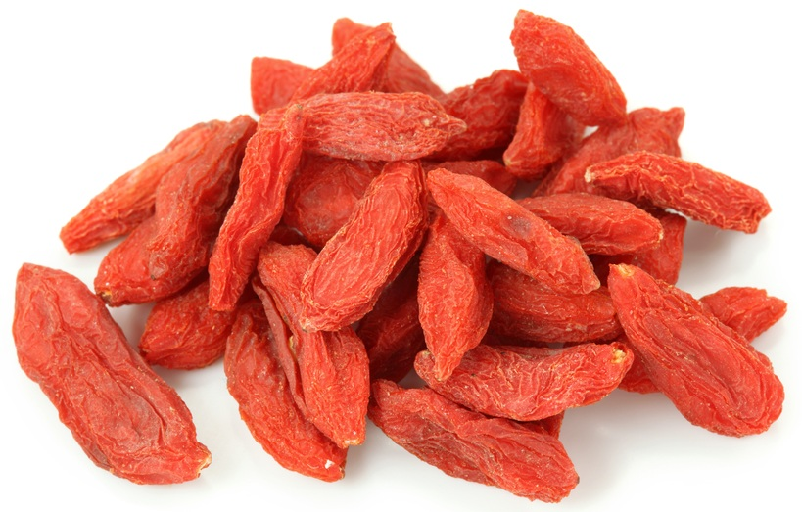
TOP 15 SUPERFOODS
GOJI BERRIES
This Superfood contains 18 kinds of amino acids, all 8 essential amino acids
up to 21 trace minerals
high amounts of antioxidants, iron, polysaccharides, B & E vitamins, and many other nutrients.

Slide 9
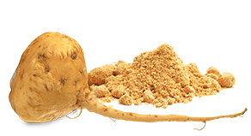
TOP 15 SUPERFOODS
MACA
A staple in the Peruvian Andes for thousands of years
increases energy, endurance, strength, and libido.
Dried maca powder contains more than 10% protein
nearly 20 amino acids & 7 essential amino acids.
As a root crop, maca contains five times more protein than a potato and four times more fiber.

Slide 10
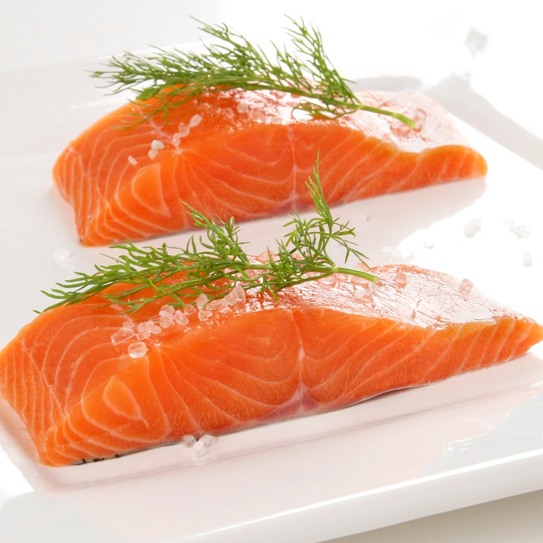
TOP 15 SUPERFOODS
SALMON
Rich In Omega-3 Fatty Acids Is Known To Reduce Risk Of Heart Disease
The American Heart Association Recommends Consuming Fish Twice A Week To Reduce Risk Of Heart
Be Sure To Buy Wild Caught Fish Not Farmed
REF: www.nps.ars.usda.gov.

Slide 11
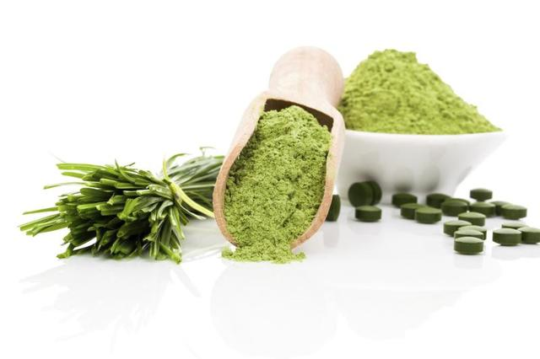
TOP 15 SUPERFOODS
SPIRULINA & BLUE-ALGAE
The world's highest source of complete protein (65%)
provides a vast array of minerals, trace elements, phytonutrients and enzymes.
Blue-green algae is a wild-grown superfood with a 60% protein percentage, but is equally or exceedingly higher in other components.

Slide 12
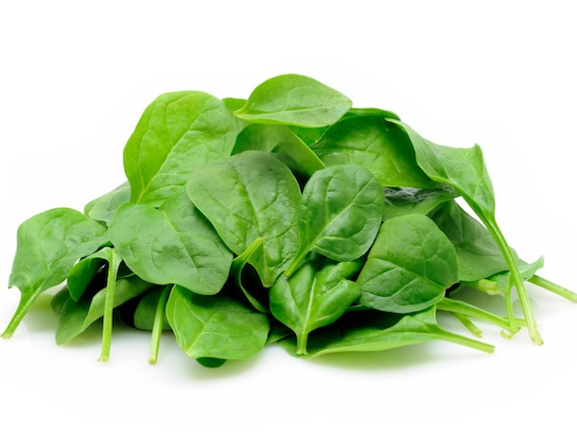
TOP 15 SUPERFOODS
SPINACH
Reduces Risk Of:
Age Related Macular Degeneration (AMD)
Cataracts
Cardiovascular Disease Including Stroke And Coronary Artery Disease
Cancer Including Colon, Lung, Skin, Oral, Stomach, Ovarian, Prostate And Breast Cancer
REF: Dr. Pratt-superfoodsrx

Slide 13
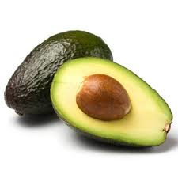
TOP 15 SUPERFOODS
AVOCADOS
They Are One Of The Best Sources Of Monosaturated Fats
Great Source Of Potassium
Ref: Dr. Mercola: Potent “Superfoods” That Can Improve Your Health And Increase Longevity November 22, 2012
Notes:
twice as much Potassium as a banana. This makes it an excellent replacement for grain carbs and other sources of sugar. Remember, when cutting out carbs, you need to replace those calories with healthy fat, which is actually a far better source of energy for your body and brain than carbohydrates.

Slide 14
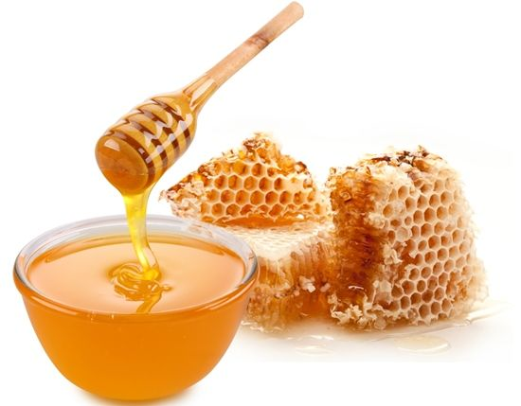
TOP 15 SUPERFOODS
BEE PRODUCTS
(HONEY, POLLEN, PROPOLIS)
Contains vitamin B-9 and all 21 essential amino acids, making it a complete protein.
Honey, in its organic/wild, raw, unfiltered states is rich in minerals, antioxidants, probiotics, enzymes, and one of the highest vibration foods on the planet.

Slide 15
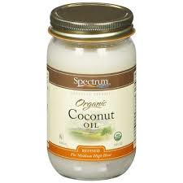
TOP 15 SUPERFOODS
COCONUT OIL
Anti-viral and anti-bacterial
Stimulates metabolism
Replacement for unhealthy carbs
REF: Dr. Mercola: Potent “Superfoods” That Can Improve Your Health and Increase Longevity November 22, 2012
Notes:
50 percent of the fat content in coconut oil is a fat rarely found in nature called lauric acid that your body converts into monolaurin, which has anti-viral, anti-bacterial and anti-protozoa properties. Coconut oil is about 2/3 medium-chain fatty acids (MCFAs), which produce a whole host of health benefits, including stimulating your metabolism. MCFA's are also immediately converted to energy — a function usually served in the diet by simple carbohydrates — so like avocados, coconut oil is an ideal replacement for unhealthy grain carbs.

Slide 16
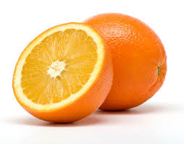
TOP 15 SUPERFOODS
ORANGES
Anti-viral And Anti-bacterial
Stimulates Metabolism
Replacement For Unhealthy Carbs
Ref: Dr. Mercola: Potent “Superfoods” That Can Improve Your Health And Increase Longevity November 22, 2012

Slide 17
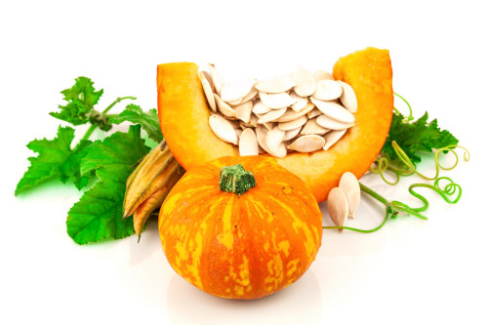
TOP 15 SUPERFOODS
PUMPKIN
Anti-viral And Anti-bacterial
Stimulates Metabolism
Replacement For Unhealthy Carbs
Ref: Dr. Mercola: Potent “Superfoods” That Can Improve Your Health And Increase Longevity November 22, 2012

Slide 18
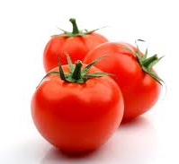
TOP 15 SUPERFOODS
TOMATOES
Anti-viral And Anti-bacterial
Stimulates Metabolism
Replacement For Unhealthy Carbs
Ref: Dr. Mercola: Potent “Superfoods” That Can Improve Your Health And Increase Longevity November 22, 2012

Slide 19
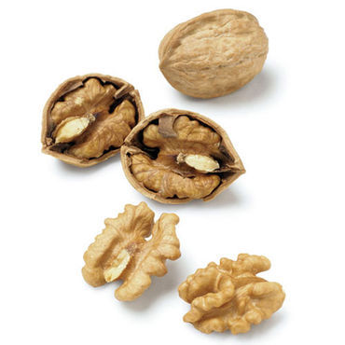
TOP 15 SUPERFOODS
WALNUTS
Anti-viral And Anti-bacterial
Stimulates Metabolism
Replacement For Unhealthy Carbs
Ref: Dr. Mercola: Potent “Superfoods” That Can Improve Your Health And Increase Longevity November 22, 2012

Slide 20
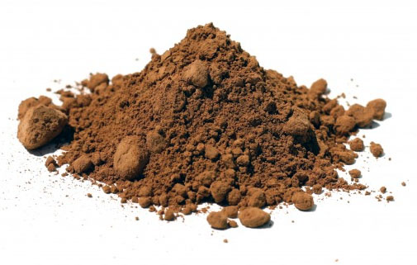
TOP 15 SUPERFOODS
CACAO (RAW CHOCOLATE)
the highest antioxidant food on the planet,
#1 source of magnesium, iron, chromium and is also extremely high in PEA, theobromine (cardiovascular support), and anandamide ("bliss chemical").
Raw Chocolate balances brain chemistry, builds strong bones, is a natural aphrodisiac, elevates your mood and energy.

Slide 21
“SO-CALLED” SUPERFOODS THAT SHOULD BE AVOIDED
BEANS
They Are Relatively High In Carbohydrates And Are Loaded With Lectins That May Be Incompatible With Many People.
It Is Also High In Phytic Acid Which Is A Potent Mineral Chelator.
If You Are Going To Use Beans They Need To Be Soaked For 24 Hours Or Longer And Frequently Changing The Water.
REF: Dr. Mercola: Potent “Superfoods” That Can Improve Your Health and
Increase Longevity November 22, 2012
Notes:
The primary concern with beans is that they are relatively high in carbohydrates and are loaded with lectins that may be incompatible with many people. It is also high in phytic acid which is a potent mineral chelator. If you are going to use beans they need to be soaked for 24 hours or longer and frequently changing the water. They are not perniciously deadly foods, but they in no way shape or form qualify as a superfood.

Slide 22
“SO-CALLED” SUPERFOODS THAT SHOULD BE AVOIDED
LOW-FAT YOGURT
Low-fat Yogurt Is Also Pasteurized And Typically Loaded With Added Fructose.
Opt For Homemade Fermented Yoghurt, Using Either Raw, Ideally Pastured Organic Raw Milk, Full Fat Organic Milk (Not Low Fat Or Skim)
Ref: Dr. Mercola: Potent “Superfoods” That Can Improve Your Health And Increase Longevity November 22, 2012
Notes:
Low-fat yogurt:
Not only is the low-fat ideology completely false, low-fat yoghurt is also pasteurized and typically loaded with added fructose. Taken together, these three factors put commercial low-fat yoghurt squarely on my list of items to avoid.

Slide 23
“SO-CALLED” SUPERFOODS THAT SHOULD BE AVOIDED
SOY
The Risks Of Consuming Unfermented Soy Products Far Outweigh Any Possible Benefits.
Genetically Engineered Soy Pose Additional Health Hazards
The Only Type Of Soy I Recommend Is Traditionally Fermented Organic Soy Products
REF: Dr. Mercola: Potent “Superfoods” That Can Improve Your Health and Increase Longevity November 22, 2012

Slide 24
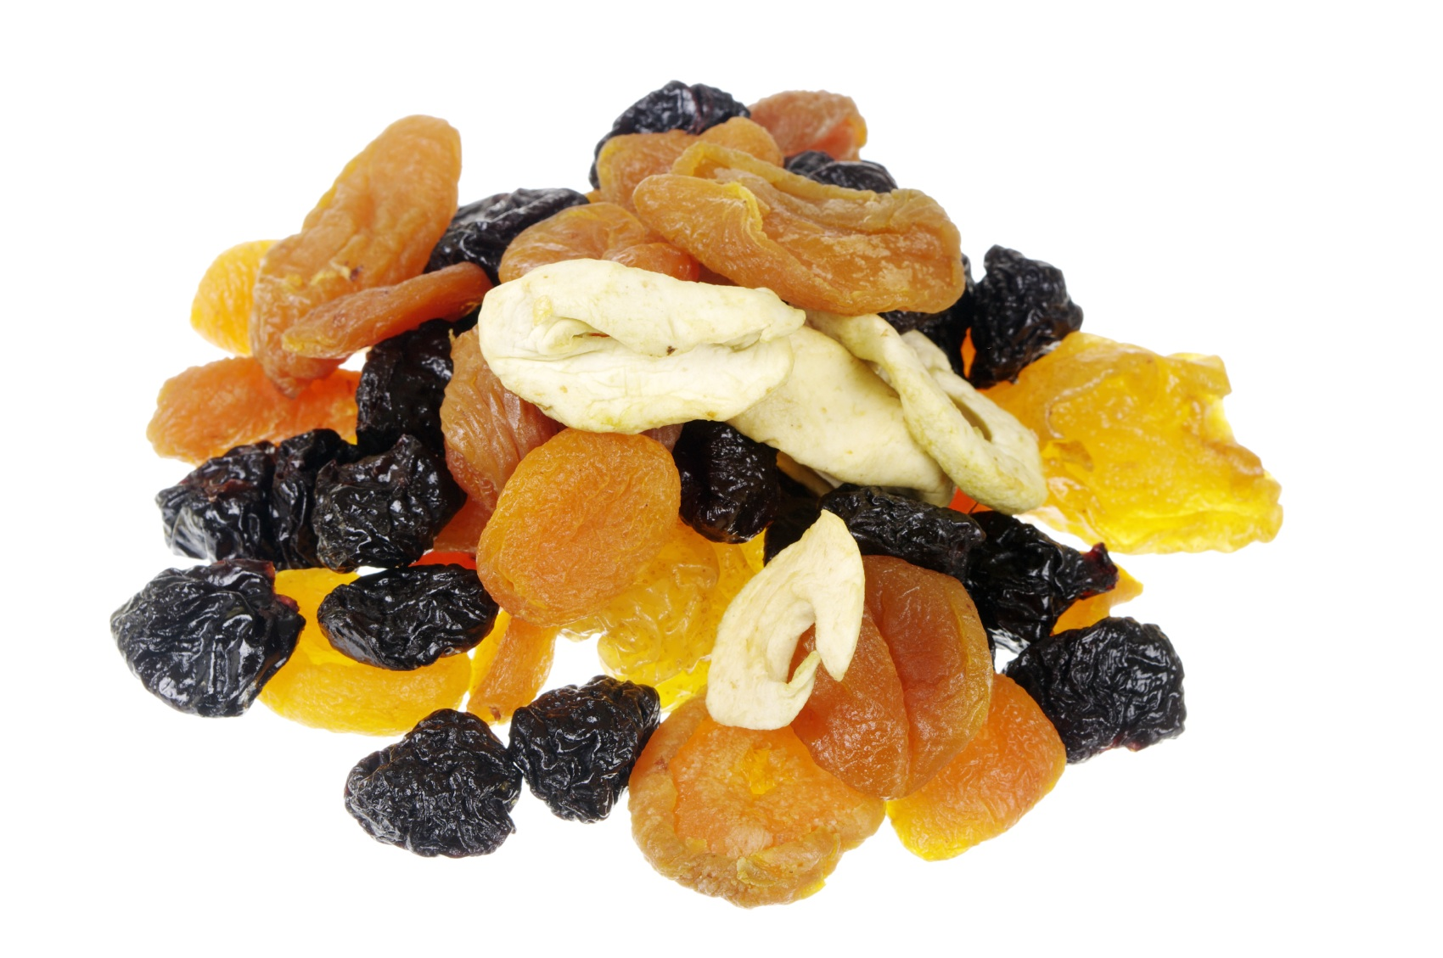
“SO-CALLED” SUPERFOODS THAT SHOULD BE AVOIDED
DRIED FRUITS
High In Fructose
REF: Dr. Mercola: Potent “Superfoods” That Can Improve Your Health and Increase Longevity November 22, 2012
Notes:
While whole fruits are excellent sources of nutrients and antioxidants if consumed in moderation, they also tend to be high in fructose, and dried fruits even more so. If you are in the minority of people who are not struggling with insulin resistance, then small amounts of dried fruit would probably be fine, but if you have type 2 diabetes, are pre-diabetic, obese, hypertensive, or have symptoms of heart disease, you're better off avoiding dried fruits until your weight and insulin levels have normalized

Slide 25
JUICE?
Fresh Juice Is The 15 Minute Nutrient Express To Health.
Fresh juices go directly into your bloodstream and are therefore considered a 15 min. nutrient express to health. Unfortunately store bought juices contain virtually no nutrients due to the pasteurization process.
2. Juicing Lets You Add A Wide Variety Of Fruit & Vegetables To Your Diet.
Many of us eat the same vegetables and fruits every day or worse, don't even eat any on a regular basis! With juicing, you can enjoy a wide variety of vegetables that you don't enjoy eating whole. Juicing is also the perfect way to consume the recommended daily serving of vegetables.
3. Fresh Juice Offers Incredible Health Benefits.
After regularly consuming freshly pressed vegetable juices, which are highly alkalizing, you will experience improved energy levels, digestion and mental clarity, clearer skin, and an overall sense of wellbeing.

Slide 26
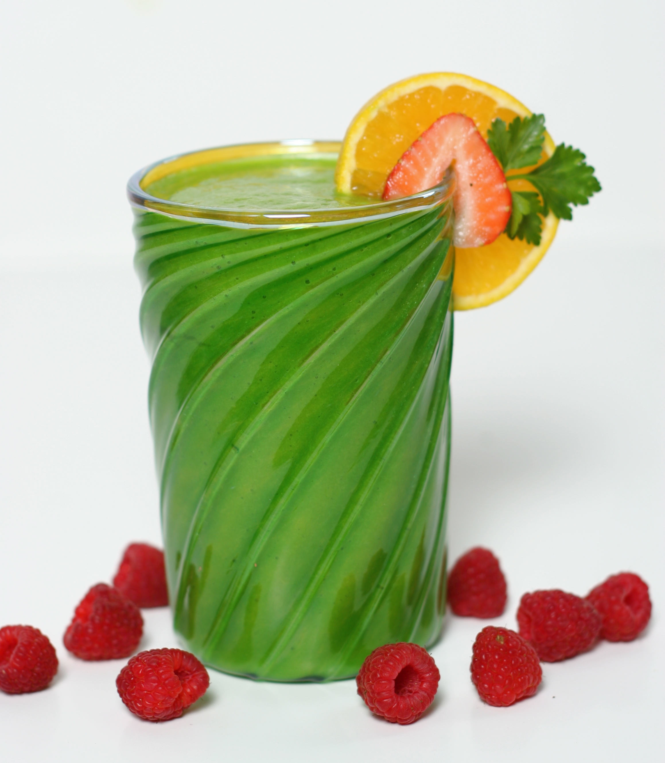
BASIC GREEN DRINK
1-1/2 To 2 Cups Chilled Coconut Water
1 Cup (Packed) Baby Spinach Leaves
1 Cup (Packed) Kale Or Swiss Chard Leaves, Removed From Stem
1 Apple, Cored And Roughly Chopped
1 English Cucumber, Roughly Chopped
Small Handful Fresh Mint Leaves
Small Handful Fresh Italian Flat-leaf Parsley Leaves
Juice Of One Lemon Or Lime
Optional Add-ins (Mix And Match, To Taste)
1 Tsp Fresh Ginger
1/2 Cup Frozen Blueberries And/Or Blackberries
1/2 Cup Frozen Pineapple And/Or Mango Chunks
Chia Or Flax Seeds

Slide 27
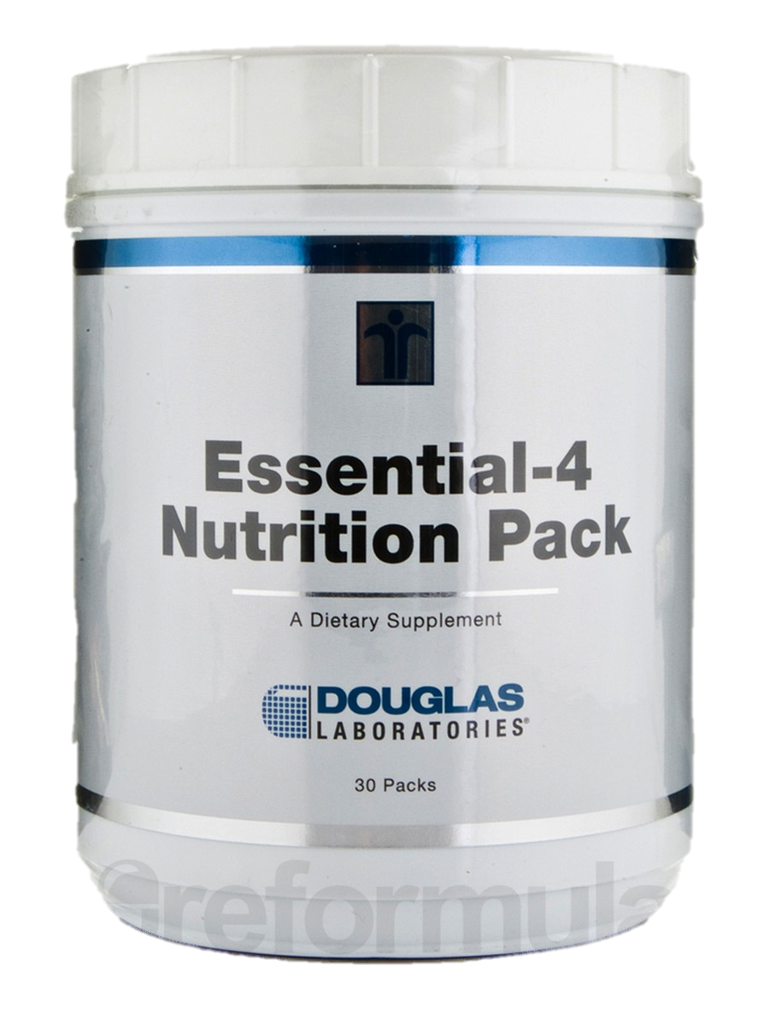
Special: 15% Off
Each packet of Douglas Labs’ Essential-4 contains four supplements:
Ultra Preventive X—similar to folic acid or vitamin D3‚ which offer many health benefits.
Opti-EPA—provides omega 3-fatty acids to support heart health and boost brain power.
Multi-Probiotic 4000—helps maintain and stabilize the intestinal tract and digestive system by working to increase levels of good bacteria and rid your body of bad bacteria.
Citrus Solu-Q—a source of CoQ10‚ a powerful antioxidant.
Regularly: $_____ Now ONLY: $____
XX.XX
XX.XX

