Slide 1

Secrets To
True Health Unveiled
HOW TO LIVE & ENJOY LIFE LIKE YOU ARE 20 YEARS YOUNGER
Let’s Start

Slide 2

My Story
MY GOAL:
Teach You The Difference Between True Well-Being & Lack Of Symptoms
Give You Easy Action Steps To Feel, Look, & Live 20 Years Younger
Give You An Opportunity To Become Your Best Self
To create Inspired & Energetic Living

Slide 3

IT’S TIME FOR A
PARADIGM SHIFT

Slide 4
LEADING CAUSE OF DEATH GLOBALLY
#1
HEART DISEASE
  17.9 Million Deaths
  Per Year
  More Than 23.6 Million By 2030.
Notes:
Reference: Heart disease and stroke statistics2018 update: a report from the American Heart Association [published online ahead of print January 31, 2018]. Circulation. DOI: 10.1161/CIR.0000000000000558.

Slide 5

LEADING CAUSE OF DEATH GLOBALLY
#2
CANCER
609,920 Deaths / Yr
1,650 People / Day
1 Of Every 4 Deaths
Notes:
American Cancer Society 2017: https://www.cancer.org/content/dam/cancer-org/research/cancer-facts-and-statistics/annual-cancer-facts-and-figures/2017/cancer-facts-and-figures-2017.pdf

Slide 6
LEADING CAUSE OF DEATH GLOBALLY
  250,000 Deaths Due To Medical Mistakes Per Year
#3
MEDICINE
Notes:
Reference:
https://www.cnbc.com/.../medical-errors-third-leading-cause-of-death-in-america.html

Slide 7
INSIDE HEALTH CARE COSTS IN U.S.
The Three Most Expensive
Diseases In 2013:
Diabetes ($101 Billion),
The Most Common Form Of Heart Disease ($88 Billion)
Back & Neck Pain ($88 Billion)
MOST ARE PREVENTABLE!
Notes:
REFERENCE: JAMA STUDY
https://www.washingtonpost.com/news/wonk/wp/2016/12/27/the-u-s-spends-more-on-health-care-than-any-other-country-heres-what-were-buying/?noredirect=on&utm_term=.9d3231d0a460

Slide 8

“Inside your body is a wonderful pharmacy. You name it, the human body can make it --tranquilizers, sleeping pills, anti-cancer drugs; the right dose at the right time for the right organ with no side effects. And all the instructions you need come with the packaging which is your Innate Intelligence.”

Slide 9
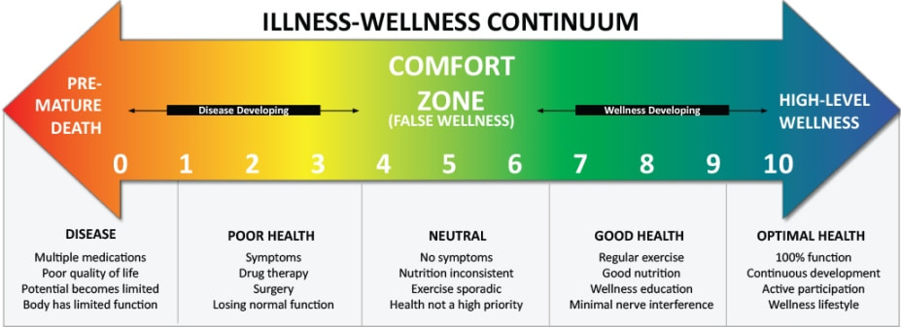
WHAT IS HEALTH?

Slide 10

ALLOPATHY
ALLO – Opposite
PATHY – Suffering
The Focus:
To bring about the opposite of suffering
Notes:
Now medicine IS important is emergency situations…but for real health care…for getter your body to express it’s optimal health and healing potential…it is not. There was always a pill, potion or shot to cure our ailments or help with bringing about the opposite of suffering.
If I were in an accident and I needed a pain killer…then bring on the morphine. That’s where we need medicine. And currently in North America, we are ranked #37 out of 50 in health care…in all industrialized nations.

Slide 11

WELLNESS
WELL – IN GOOD HEALTH
NESS – ACT OF
FOCUS:
Emphasis on preventing illness
and prolonging life, as opposed to
emphasizing treating diseases.
Notes:
Now medicine IS important is emergency situations…but for real health care…for getter your body to express it’s optimal health and healing potential…it is not. There was always a pill, potion or shot to cure our ailments or help with bringing about the opposite of suffering.
If I were in an accident and I needed a pain killer…then bring on the morphine. That’s where we need medicine. And currently in North America, we are ranked #37 out of 50 in health care…in all industrialized nations.

Slide 12


1.9 million hospitalizations a year
2.74 million serious adverse drug reactions
128,000 people die from prescribed drugs
SIDE EFFECTS:

Slide 13
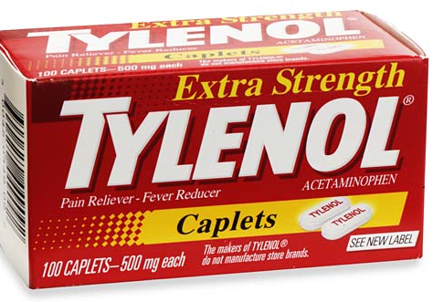
TYLENOL RISKS
Daily use for a year, increases kidney failure by 40%
Liver damage is linked to the use of Acetaminophen was reported 3 decades ago but still recommended
Children’s Tylenol now has a warning label due to 100 children deaths per year due to liver or kidney failure.
DR: 17
Notes:
REFERENCE: Health Facts, April 1996 v 21, n 203 Associated Press, Jan 5, 1996
Tylenol, if taken every day for a year, will increase the risk of kidney failure by 40%. And the pharmaceuticals knew about this link 30 years ago. It even has a warning label on it, because 100 children die every year fro the side effects of Tylenol. Their bodies cannot breakdown acetominophen, which is a toxin to the body.

Slide 14
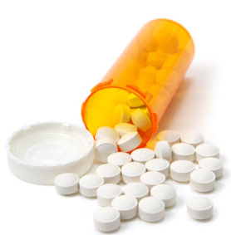
ACCORDING TO MEDICAL RESEARCH…
By far the greatest number of hospitalizations and deaths occur from drugs that are prescribed properly by physicians and taken as directed
2,460 people per week are estimated to die from drugs that were properly prescribed, and that’s based on detailed chart reviews of hospitalized patients,
Notes:
REFERENCE:
https://health.usnews.com/health-news/patient-advice/articles/2016-09-27/the-danger-in-taking-prescribed-medications

Slide 15
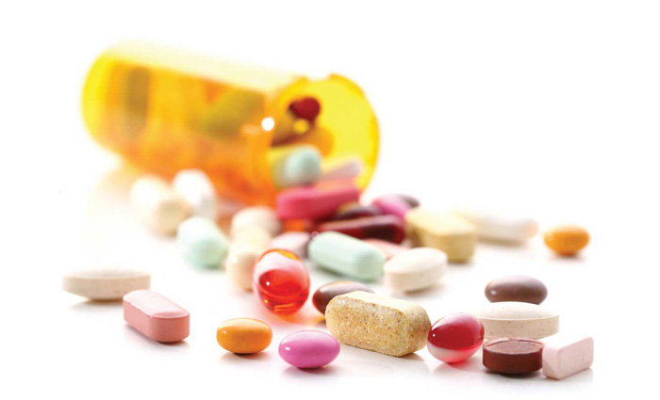
ACCORDING TO MEDICAL RESEARCH…
55% Of Americans Regularly Take 4 Prescription Medicines
Prescriptions Filled
Rose 85%
From 1997-2016
Notes:
REFERENCE: WEBMD
https://www.webmd.com/drug-medication/news/20170803/americans-taking-more-prescription-drugs-than-ever-survey

Slide 16
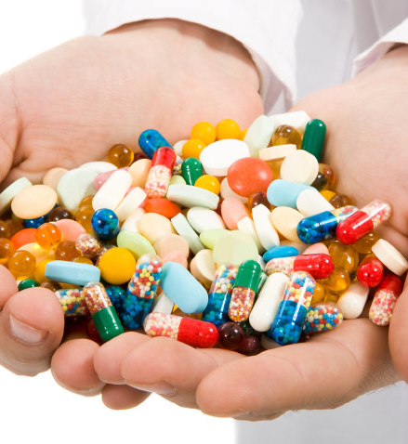
ACCORDING TO
MEDICAL RESEARCH…
U.S. is 5% of the worlds population yet we take 75% of the world’s prescribed drugs.
We are ranked 37th in health of all Industrialized nations.
Notes:
REFERENCE: WEBMD
https://www.webmd.com/drug-medication/news/20170803/americans-taking-more-prescription-drugs-than-ever-survey

Slide 17
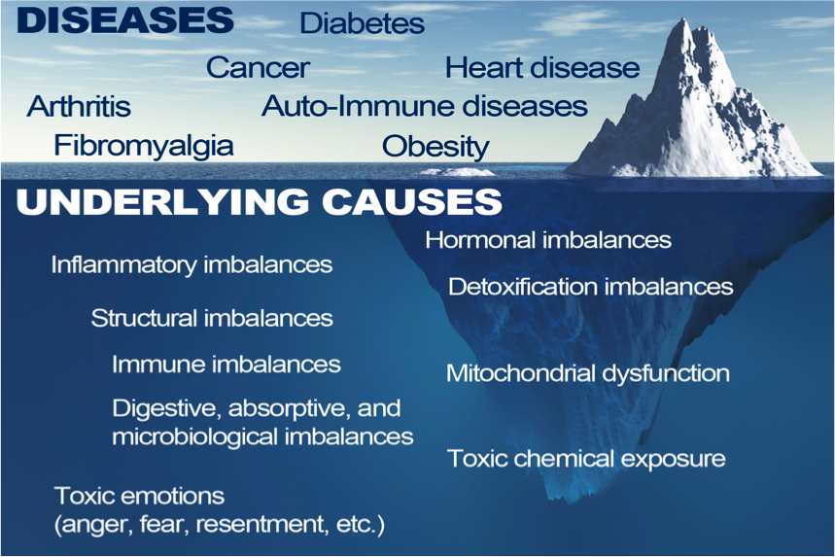
MASKING SYMPTOMS WITH DRUGS

Slide 18
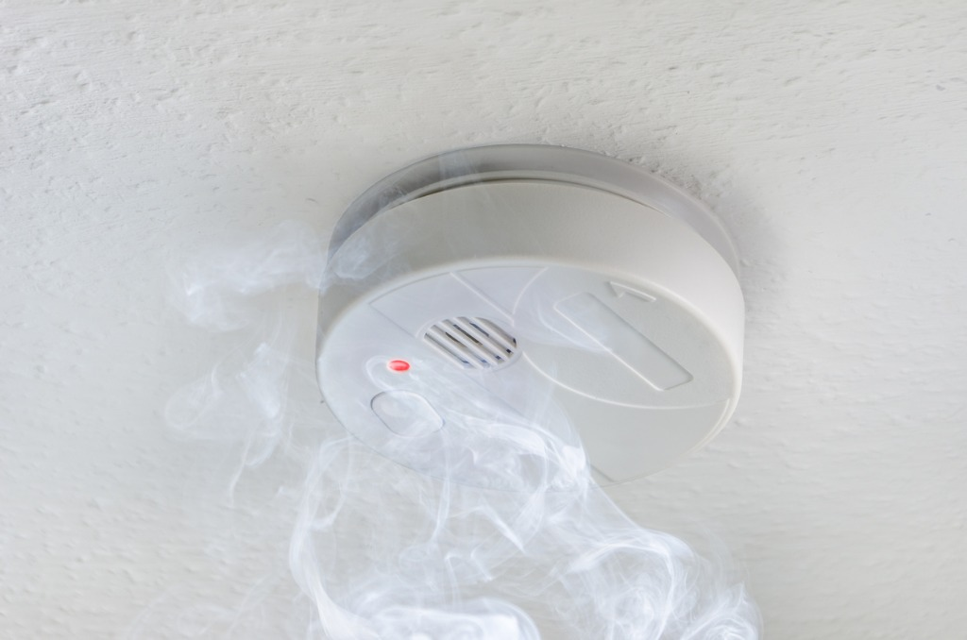
WHAT DO YOU DO WHEN THE FIRE ALARM GOES OFF?

Slide 19
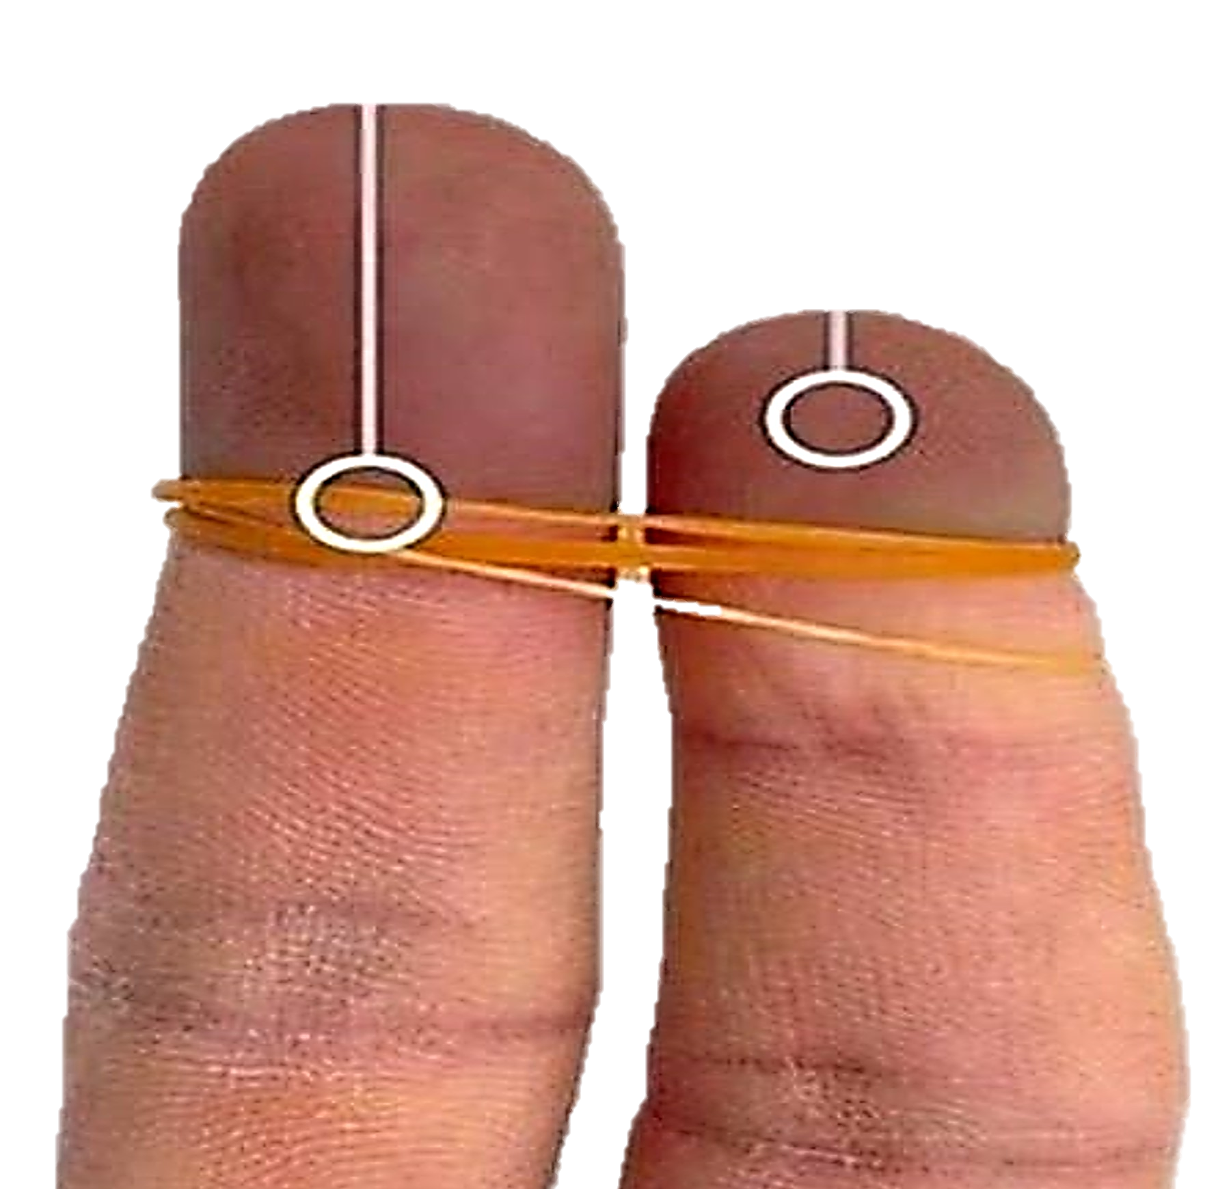
WHAT MAKES SENSE?
EFFECT
Damage To Tissues & Organs That Nerve Leads To
CAUSE
Subluxation Cutting Off Nerve Flow
1
IGNORE THE PROBLEM?
TAKE A PILL?
REMOVE A FINGER?
2
3
OR …..CORRECT THE CAUSE
OF THE PROBLEM?

Slide 20
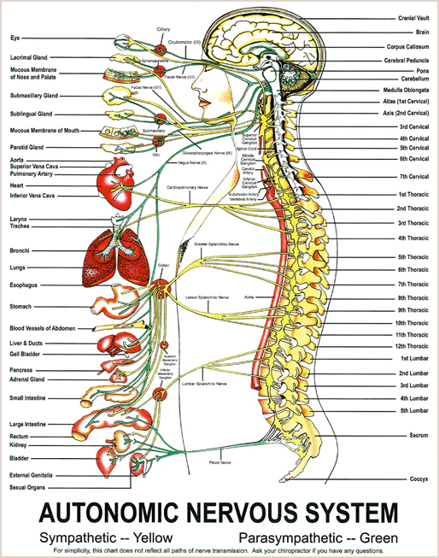
The Nervous System
Controls EVERY Muscle, Cell, Organ & Function

Slide 21
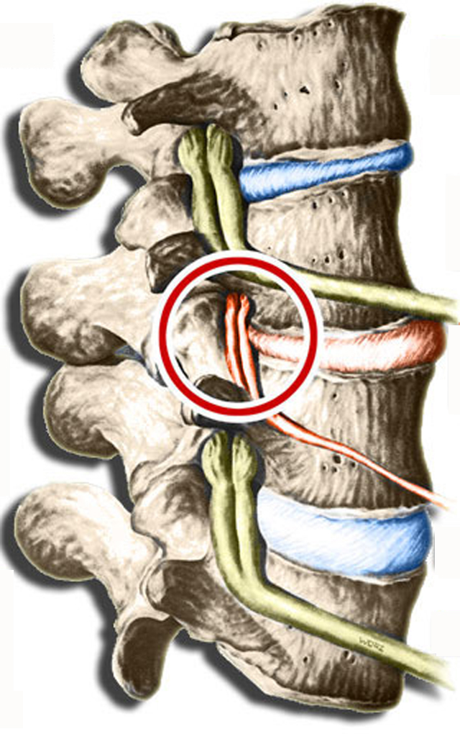
SUBLUXATIONS
A Misalignment Or Dysfunction Of The Spine Causing Interference Of The Nervous System, Interfering With The Body’s Innate Intelligence, And Preventing The Body From Properly Recognizing And Adapting To It’s Environment.
Notes:
Abnormal posture leads to a condition known as subluxations. Subluxations can lead to sickness, disease, crime and even death…directly or indirectly as it robs you of potential and expression.

Slide 22
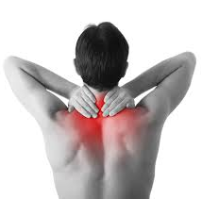
CAUSES OF SUBLUXATION
Physical Stress
Mental Stress
Chemical Stress
Electromagnetic Frequency (EMF)
Notes:
The causes of SUBLUXATION include…

Slide 23

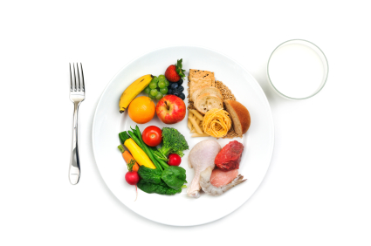
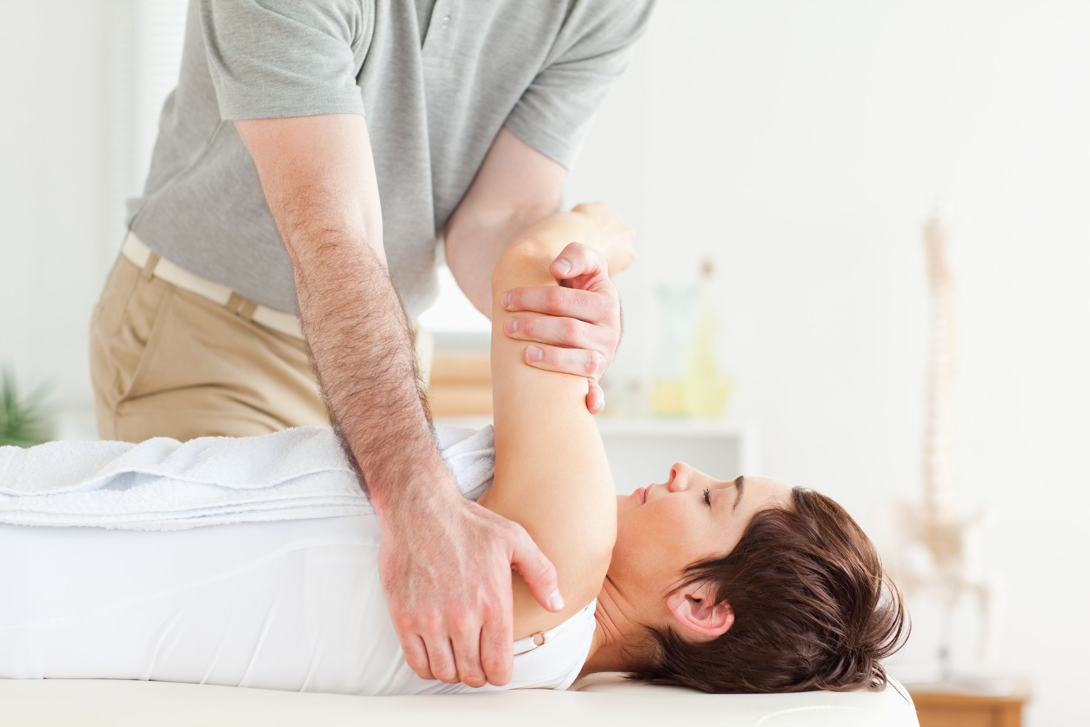

4 DIMENSIONAL MODEL
BE FIT
{PHYSICAL}
Exercise
Proper Posture
EAT RIGHT
{NUTRITION}
Supplementation
Detoxification
Body’s PH
GET ADJUSTED
{CHIROPRACTIC}
G.A.P.
THINK WELL
{EMOTIONAL}
Stress, Fatigue & Sleep
Notes:
Today…more and more people are looking for natural, drug-free healthcare. This is why we are seeing a wellness revolution happening. In order to master wellness, you MUST master each of the three components – Physical, Mental and Chemical. The healthiest people on the planet are those that are embracing and optimizing the physical, nutritional and emotional aspects of their health.

Slide 24

WHERE DOES SICKNESS COME FROM?
Bacteria?
Viruses?
Bad Luck?
SUBLUXATION?
DR: 62
Notes:
So where does sickness come from? If I open up a jar of germs in this room…some of you will get sick, and some of you will not! Why is that? [WAIT FOR ANSWER]. It is not about the bacteria or the virus. It is about the degree to which you are subluxated. The greater the degree of subluxation…the greater the lowered state of health…the lower the expression of your body’s ability to adapt to outside stressors

Slide 25
G.A.P.
General Adaptation Potential
Notes:
When you immerse yourself in the 4 dimensional model of health, you also improve your General Adaptation Potential…your GAP. When you stay adjusted on a regular basis…you improve your GAP. When you exercise and eat nutritional, whole foods…you increase your GAP. This allows your body to adapt better to stressors that can be physical, chemical or emotional in nature.

Slide 26
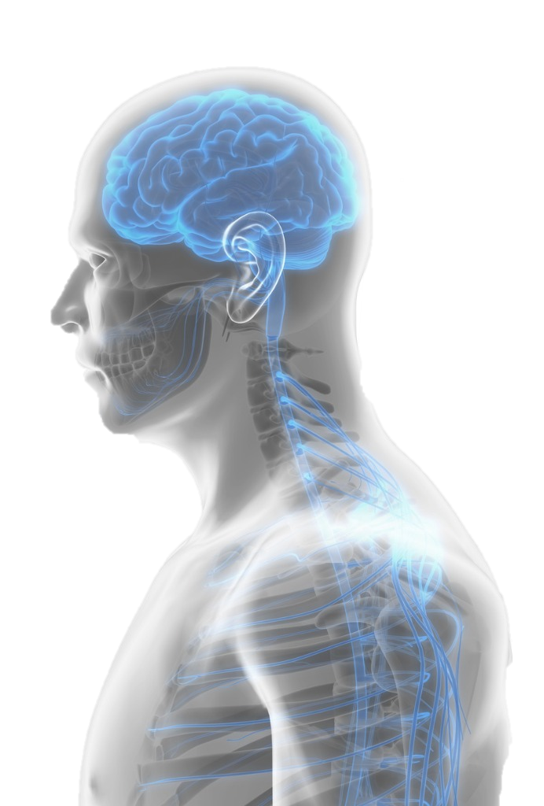
Nervous System Function
COMMAND CENTER
Of The Entire Body
(Every, Organ, Tissue, And Cell Function)
IMMUNE SYSTEM
Responsible for the Function and regulation of the immune system
01
02
DAILY CHOICES
Directly Affected By The Positive & Negative Lifestyle Choices We Make Daily
DIGESTION
Regulates The Speed At Which Food Moves Through The Digestive Tract.
03
04

Slide 27
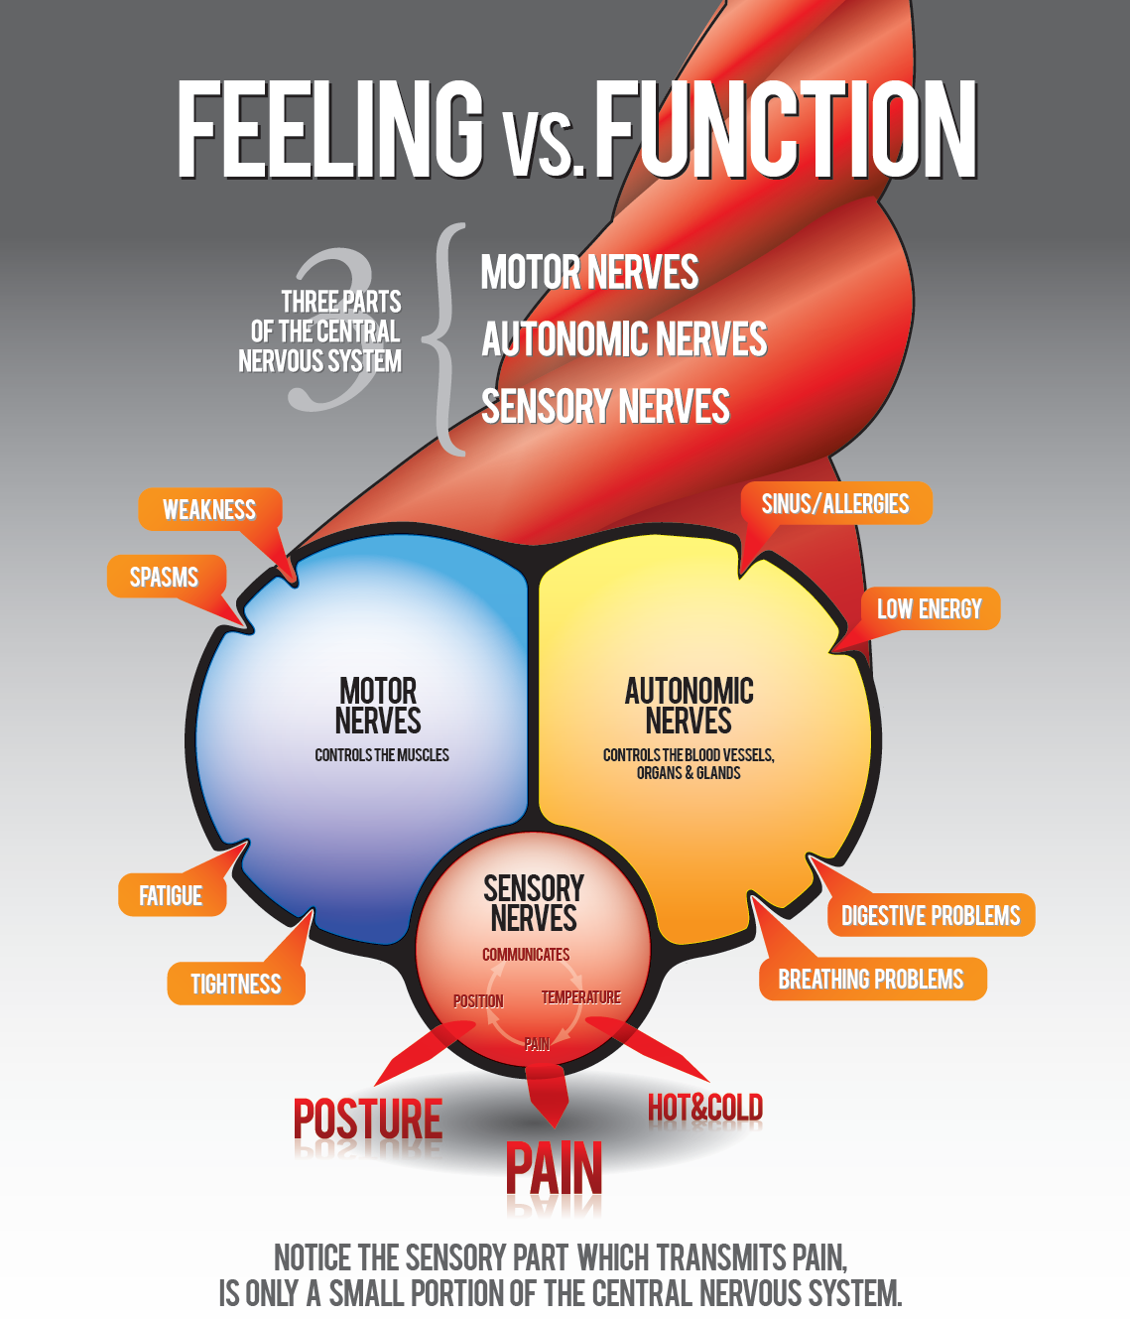
Only 10% Of The Nerve Is Made Up Of PAIN Receptors
90% Controls Function
Notes:
This is an amazing tool to use inside of your practice. You can get the poster with complete image at: http://www.davemagergameface.com/product/feeling-vs-function-poster-pad/

Slide 28
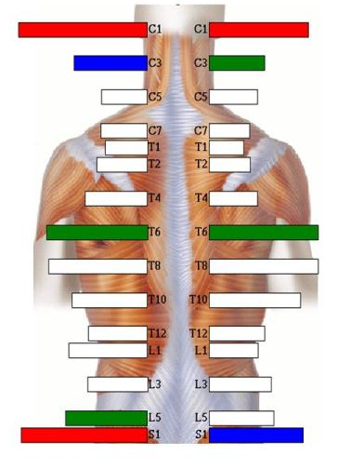
CARE & FREQUENCY
“The less healthy the patient (based on function and not symptoms), the more adjustments they will need to create a healthy nervous system that has been lost due to subluxation.”
Furman & Gallo
The Neurophysiology of Human Behavior
Notes:
We base your adjustment schedule not on how you are feeling…but on how you are functioning. Here is an example using the Insight Subluxation Station By CLA. If you do not have the sub-station, then you can replace the image with any technology that you use.

Slide 29


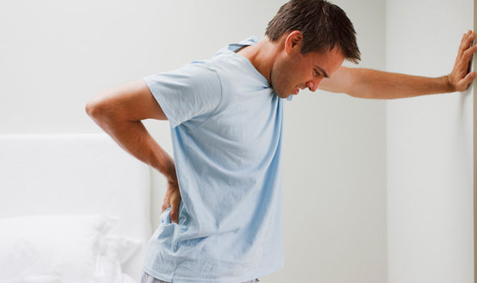
MANY KNOW CHIROPRACTIC HELPS
NECK PAIN
HEADACHES
LOW BACK PAIN
BUT DO YOU KNOW…..

Slide 30
CHIROPRACTIC BENEFITS
CHILDREN
Under Chiropractic Care Are Less Prone To Infectious
Such As Ear Infections, Tonsillitis, And Allergies
BLOOD PRESSURE
Cervical adjustments had the effect as 2 blood pressure drugs
01
02
BABIES
Greatly Reduces Colic Symptoms
INFLAMMATION
Reduces inflammatory cytokines
03
04

Slide 31
72%
CHIROPRACTIC CARE
50%
CORTICOSTEROID
INJECTIONS
Notes:
Reference: www.Draxe.com
Compared to most medical treatments, few interventions can initiate back pain relief and healing like chiropractic adjustments can. The European Spine Journal published findings from a clinical trial uncovering how chiropractic adjustments resulted in a 72 percent success rate in treating sciatica-related symptoms. This can be compared to a 20 percent success rate from treatment with physical therapy, and a 50 percent success rate from corticosteroid injections.

Slide 32
THE FULL EXPRESSION OF INNATE INTELLIGENCE IS HEALTH
Brain
Brain
Breakdown
Repair
Nervous System
Subluxation
Body
Body
Mal-function
100% Function
100% Ease
Dis-Ease
Rx, Sx
Symptoms
100% Optimal Health & Healing
Early Death
Notes:
Here’s a diagram showing how your body works. The brain is connected to the body by way of the nervous system. When there is no interference and we have optimal nerve flow, there is 100% function of every cell, tissue and organ in the body. The body then works in a state of ease or normalcy, harmony or what we call homeostasis with it’s environment. The body can optimally heal and health is expressed at 100%.
But the body can breakdown from gravity, traumas, stressors like work, sports, chemicals…even the birth process itself. This breakdown creates SUBLUXATION…misalignments in the spine that can lead to severe nerve interference. The body no longer works in a state FUNCTION…but in a state of MAL-FUNCTION. Think of a dimmer switch that is turned down by 40, 50 or even 60%. That’s your body! There’s a lack of proper nerve flow to every cell, tissue and organ in the body. The body no longer works in a state of function, but in a state of MAL-FUNCTION. It no longer can recognize and adapt to it’s environment…or a state of ease, harmony and normalcy…but works in a state of DIS-EASE. The body’s innate intelligence sends out warning signals or symptoms or body signals. This is a good thing to have or else you would continue to hurt yourself. Medicine will give you a drug (Rx) or remove that organ (Sx).
Chiropractic works…through the power of an adjustment to remove that inference…allowing the body to heal itself and repair itself…moving to the left of this diagram…allowing the body to function once again at 100%.

Slide 33
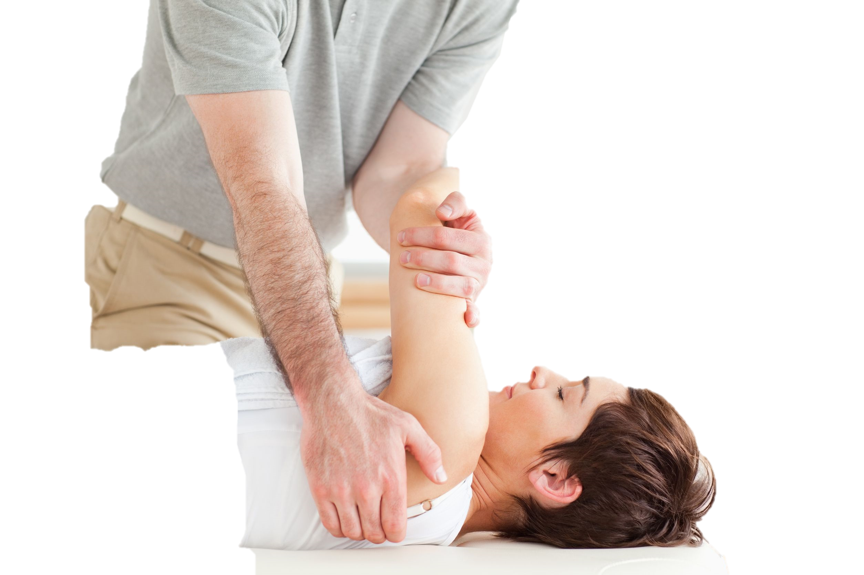
ADJUSTMENT
AD – To bring to center
JUST – To balance
MENT – MIND
“To bring the mind back to center, to balance the body, to give the body the chance to better adapt to the stressors in its environment”
Notes:
What we use is the power of life by adjusting the spine, thus effecting the nervous system and thus maximizing the expression of the potential within…LIFE! HEALTH! Without 100% expression of one’s innate intelligence…there cannot be 100% health

Slide 34
CHEMISTRY OF LIFE
Subluxations
Health & Vitality
Bones
Chemistry In Balance
Irritated
Nerves
Glands Working Properly
Dis-Harmony
Glands
Nerves Free From Irritation
Imbalance
Chemistry
Adjustment
Innate Intelligence
Illness & DIS-Ease
Notes:
Ref: Dr. Reggie Gold The N Chart Chemistry of Life

Slide 35
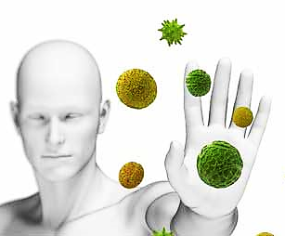
BOOSTING YOUR IMMUNITY
Chiropractic patients had a 200% greater immune competence
than those without
400% greater immune competence than those with cancer or other serious diseases.
Notes:
REFERENCE:
The Pero study
Dr. Ronald Pero, Ph.D.
Chief of Cancer Prevention
New York’s Preventive Medicine Institute

Slide 36

RAND STUDY SENIORS
87% of Chiropractic patients had good to excellent health status
The Chiropractic patients were also less likely to use prescription drugs and more likely to exercise regularly.
DR: 121
Notes:
CITES BENEFITS OF CHIROPRACTIC FOR ELDERLY: Senior citizens who receive Chiropractic care report better overall health, fewer symptomatic chronic conditions, less (sick) days in hospitals and nursing homes and more mobility than elderly non-Chiropractic patients. They were also less likely to use prescription drugs.

Slide 37

1979 & 2009 Pediatric Study
7 Out Of 8 Autopsies
Damage to Spine
Damage to Nervous System (hemorrhage in area around respiratory center)
Risk Factor for SIDS
Notes:
REFERENCE: Floyd Gilles, M.D., Massoud Bina, M.D., Ann Sortel, M.D.
PEDIATRICS, MAY 2009
Two studies done in 1979 and 2009 demonstrated that 7 out of 8 SIDS death suffered from severe subluxations from the birth process. Japanese and German researchers put chiropractors in the birthing centers and saw a significant decrease in SIDS when newborns were adjusted. This is why we make it a office policy to adjust newborns.

Slide 38
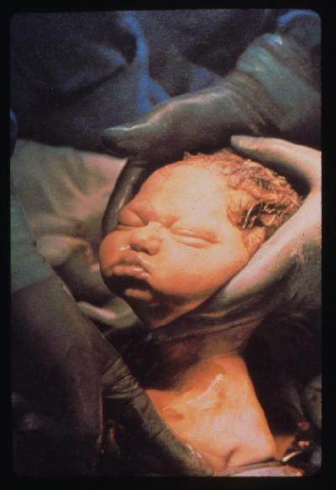
SUBLUXATION AT BIRTH
“major cause of spinal subluxation in infants is childbirth and its widespread incidence during infancy. In our mind, stressing the need for correction from birth so that irreversible subluxation degeneration changes do not occur.”
Abraham Towbin, M.D. Neuropathologist
Harvard Medical School
Notes:
ABRAHAM TOWBIN STUDY

Slide 39

Notes:
https://www.youtube.com/watch?v=E5NDLkBAgQM

Slide 40
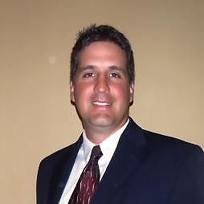
What Our Patients
Are Saying
Huge thank you to Dr. Cherine, I went to 6 doctors, 3 of which were specialists in their field and no one could figure out why I was having shooting pain I my ear. She took the time to listen and understand my issue, do the right testing and come up with a diagnosis to fix my issue,3 adjustments later and the pain is almost gone! I would recommend health first to anyone needing pain relief!
“
Notes:
REPLACE THE ABOVE TESTIMONIALS WITH YOUR PATIENT TESTIMONIALS

Slide 41

What Our Patients
Are Saying
Dr. Cherine is fantastic. The staff is very friendly and helpful. After seeing six different physicians who couldn't explain/fix my health problem, I'm thankful that Dr. Cherine has helped me get back on the road to recovery and wellness.
“
Notes:
REPLACE THE ABOVE TESTIMONIALS WITH YOUR PATIENT TESTIMONIALS

Slide 42
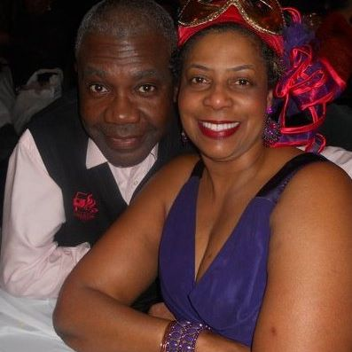
What Our Patients
Are Saying
The pain that I have has been with me for 12 years. I have been taking Dicofinac and other anti inflammatory drugs which is causing other problems but helped with the pain. After my 12th visit with Dr. Cherine I could function without the strong meds. Now, I am off th emeds and back to my active lifestyle. I was referred to Dr. Cherine and I refer others to her too.
“
Notes:
REPLACE THE ABOVE TESTIMONIALS WITH YOUR PATIENT TESTIMONIALS

Slide 43

What Our Patients
Are Saying
I’ve been going to Health First Chiropractic for over a year, and they have been a tremendous help to me. I work at a desk all day, and have had back and neck issues for several years. I had gotten to the point where bending far enough to put on socks was almost impossible. Dr. Cherine worked with me until I had regained former flexibility and was not experiencing any more discomfort. Since my work hasn’t changed, I continue to go in for maintenance visits so that nothing will recur. The office is attractive and relaxing, and the staff is exceptionally nice. I recommend them highly.
“
Notes:
REPLACE THE ABOVE TESTIMONIALS WITH YOUR PATIENT TESTIMONIALS

Slide 44
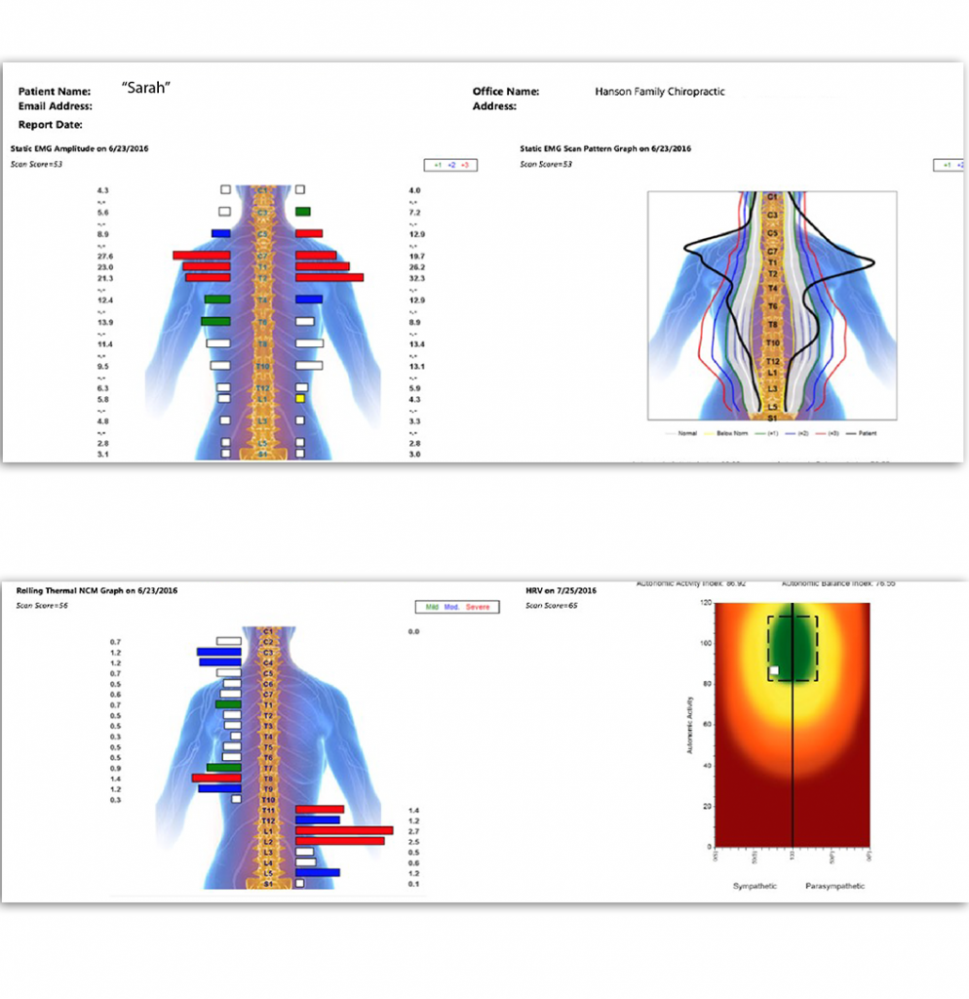
IS YOUR NERVOUS SYSTEM UNDER DISTRESS
Notes:
OPTIONAL SLIDE FOR INSUGHT SUBLUXATION STATION USERS

Slide 45

Our Charity

Slide 46

TODAY ONLY…
Complete Consultation, All Necessary X-rays If Needed, Exam & Spinal Scans For $20 For Your Entire Family.
Additional $20 Health Certificates For Friends, Relatives, & Co-Workers
An Opportunity To Achieve Your
Highest Health Potential
Notes:
Photo: Core Score By Chiropractic Leadership Alliance

Slide 47
TODAY ONLY…
Complete Consultation, All Necessary X-rays If Needed, Exam & Spinal Scans For $20 For Your Entire Family.
Additional $20 Health Certificates For Friends, Relatives, & Co-Workers
An Opportunity To Achieve Your
Highest Health Potential

