Slide 1
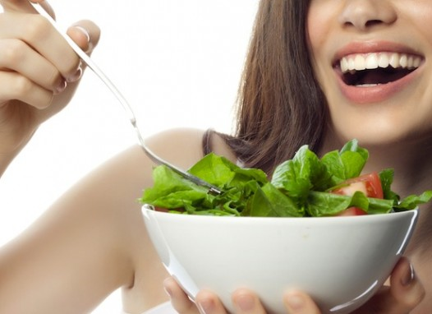
Ready To Have Strong Bones MOVE PAIN-FREE
&
Feel GREAT?!?
Join Us For An Exclusive
Workshop….
OFFERED ONLY ONCE THIS YEAR!

Slide 2
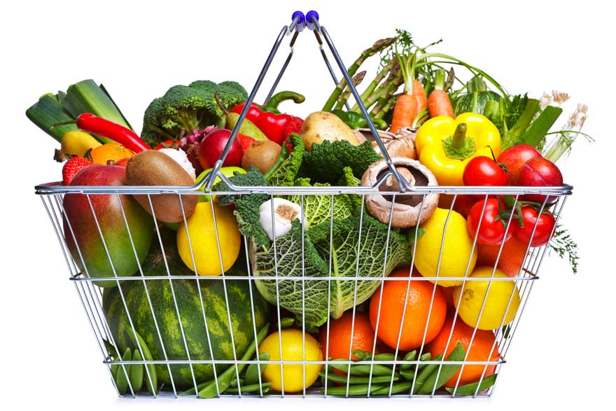
LEARN THE TOP 12 SUPERFOODS
THAT WILL KEEP YOU LOOKING AND FEELING YOUNGER

Slide 3

LEARN THE
“SO-CALLED” SUPERFOODS THAT SHOULD BE ACTUALLY BE AVOIDED

Slide 4
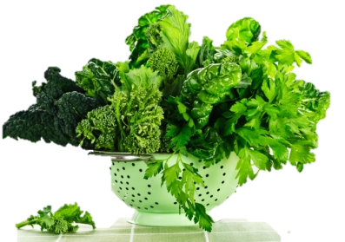
NOT ALL SUPER-FOODS ARE CONSIDERED EQUAL!
DISCOVER WHAT
TO DO & EAT
& WHAT
NOT TO!

Slide 5
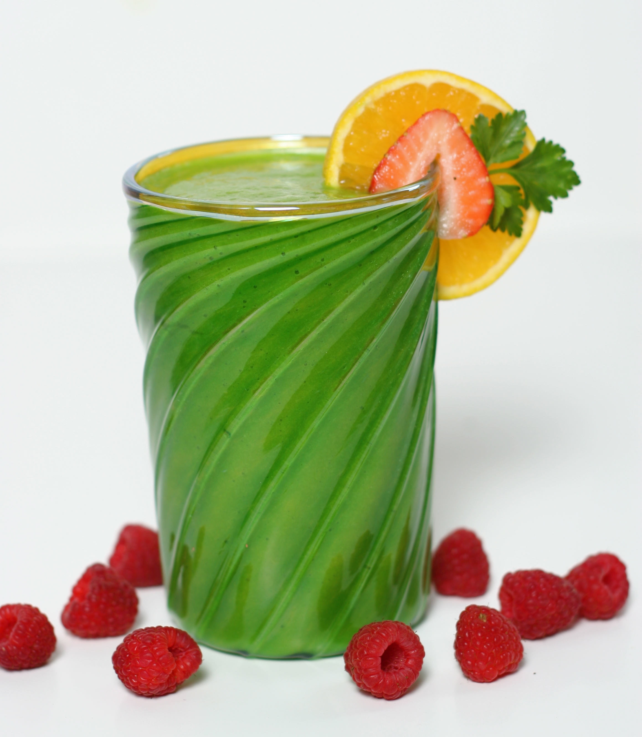
LEARN SOME OF THE YUMMIEST RECIPES THAT WILL KEEP YOU FEELING GREAT!

Slide 6
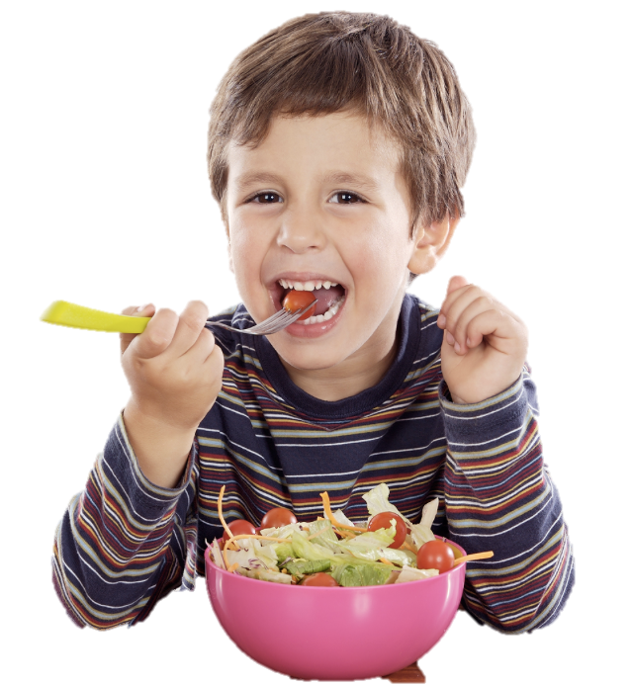
SUPER LIVING WITH SUPERFOODS
RESERVE NOW! SEATING IS LIMITED!
DATE:
June 9th
TIME:
6:00 – 7:00
LOCATION:
Health First Chiropractic
BRING YOUR FRIENDS!
EVERY GUEST GETS A COMPLIMENTARY
SPINAL & NEUROLOGICAL EXAMINATION

