Slide 1
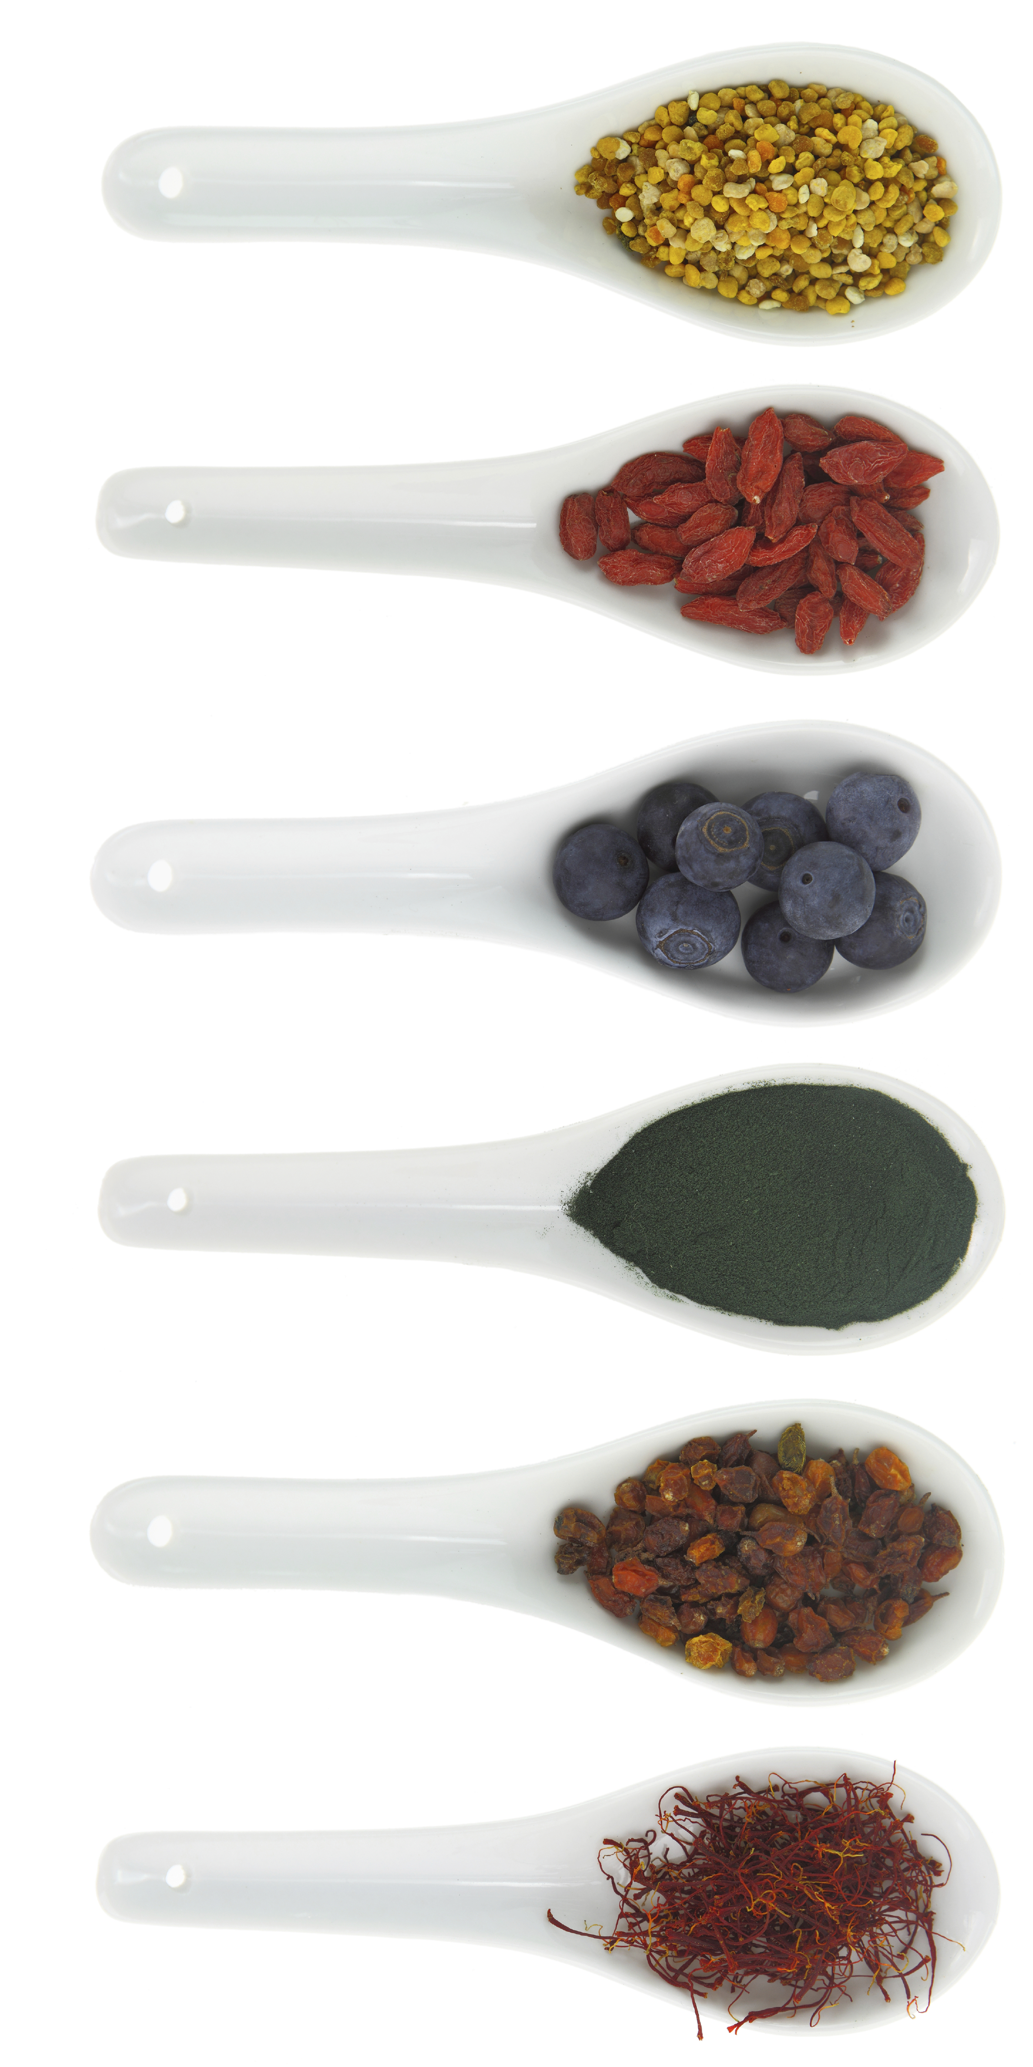


SUPER LIVING WITH
SUPERFOODS
Decrease Inflammation
Increase Energy
Look Younger
Feel Amazing
Mon. Feb. 23rd 6:00-7:00pm
Seating Is Limited!
Reserve Your Spot Today!
###-###-####

