Slide 1
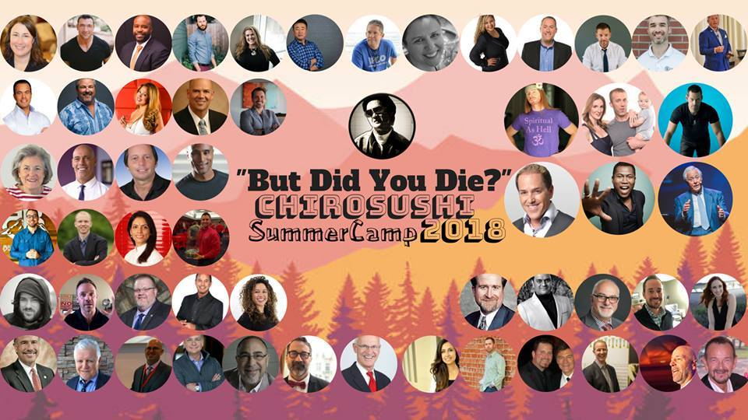
How To Serve Humanity

Slide 2
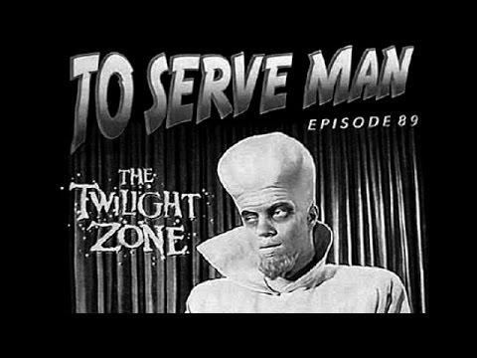
How To Serve Humanity

Slide 3
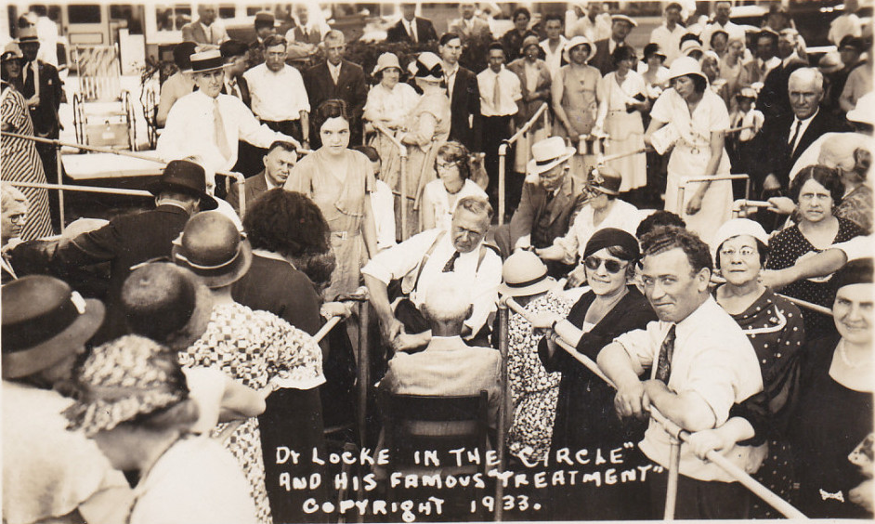

Slide 4
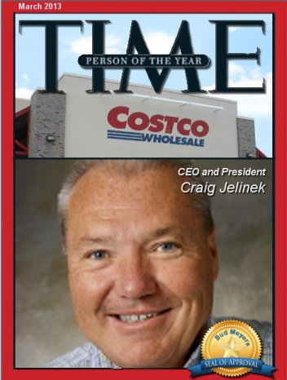
#1 Consumption Mentality & Commodity Marketing
“The Winners In Business Will Be The Companies Who Manage The Barrier To Customer Acquisition Without Reducing Brand Equity Or Lifetime Customer Value”
-Craig Jelinek, CEO of Costco

Slide 5

#2 Customer Value Optimization – CVO
Increase The Number Of Customers – VOLUME
Increase The Average Transaction Value Per Customer – UPSELL, POINT OF SALE
Increase The Number Of Transactions Per Customer – RETENTION
Increase The Number Of REFERRALS Per Customer

Slide 6
#3 YOU …..
EVERYWHERE…
NOW
Authority
Mobile Responsiveness
Podcasts, SMS, Voice Text,
Webinars, Funnels
Internet Marketing
Websites, S.E.O., Social Media, Email Marketing,
Direct Response
Meet + Greets, Direct Mail, Internal (Power Workshops), Referrals,
Dinner Workshops, Outside Lunch & Learns

Slide 7


DOMINATING THE CONVERSATION
- PENG JOON

Slide 8






DOMINATING THE CONVERSATION

Slide 9
DOMINATING THE CONVERSATION
1. Day Shoot – Brainstorm On 90 Headlines That Will Convert
- Use Polarizing Message - “Chiropractors, Here’s The Real Reason That You’re Broke!”
2. Video Bank – Upload Your Videos To A Video Bank
3. Repurpose Your Videos – Facebook, Youtube, Instagram, Instastory
- Add Subtitles To Your Message Where Possible
4. Facebook, Youtube, IG (Hootsuite, Meetedgar, Buffer)
5. Quote Cards – Take Your Best Quote, Create Your Cards On Canva, Phonto
- Cue Up On Facebook With Description
- Post On IG Stories
6. Blog Posts – Every Video Can Be Transcribed To A Blog Post (REV.COM)
7. IG Stories - > 10,000 Followers – SWIPE UP
8. Retarget Ads And Monitor Your ROI

Slide 10
DOMINATING THE CONVERSATION
Step 1 – Filming Strategies
Set time to Film (Weekly/ Monthly)
Step 2 – Editing + Posting
Set time or outsource (Upwork/Fiverr)
Step 3 – Broadcast on all Channels
Hootsuite/Buffer/MeetEdgar

Slide 11




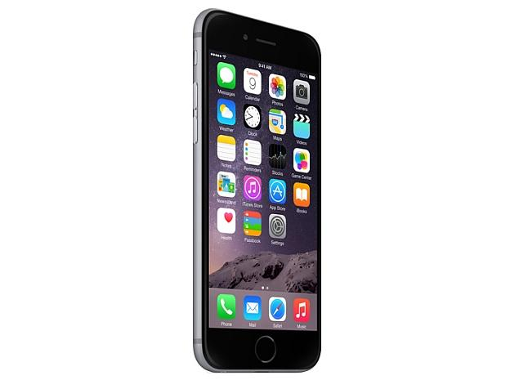
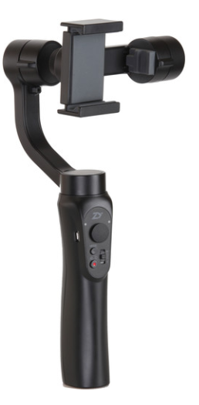
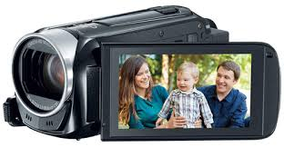









DOMINATING THE CONVERSATION

Slide 12
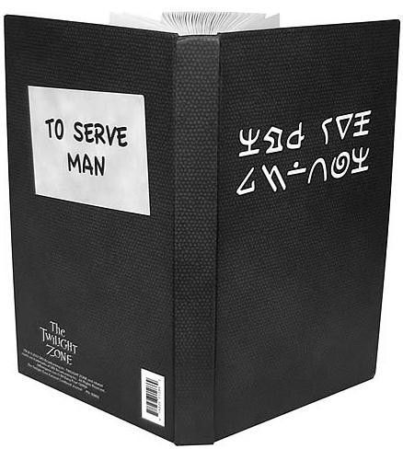

Slide 13

MY 3 GIFTS TO YOU
TEXT 474747 to Masters

